Slide 1
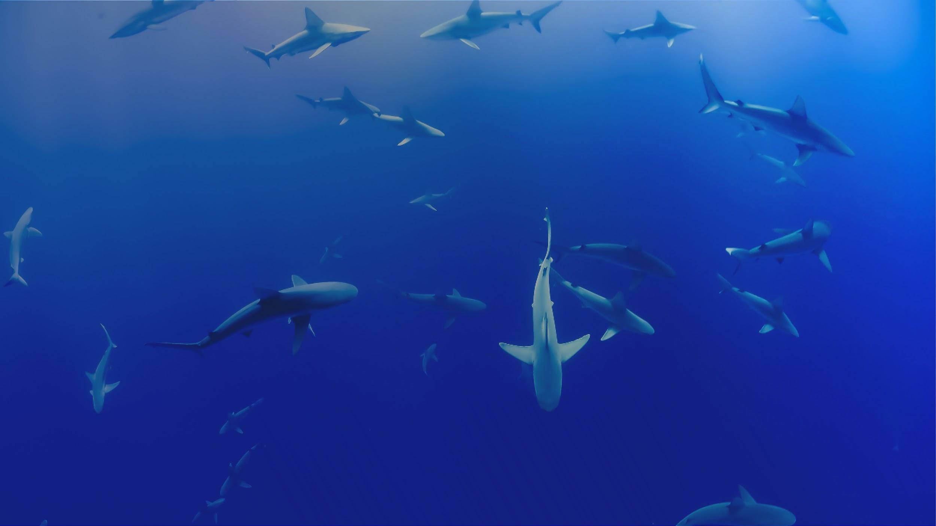


Plus de façons pour contribuer à OBIS
Jon Pye, Brian Jones, Naomi Tress
Ocean Tracking Network Data Centre
Notes:
So now that we’ve worked in the ecosystem a little bit, and hopefully we’re on board with the general mission of OBIS and want to see it succeed, let’s talk about some of the indirect ways you might be able to support this initiative.

Slide 2

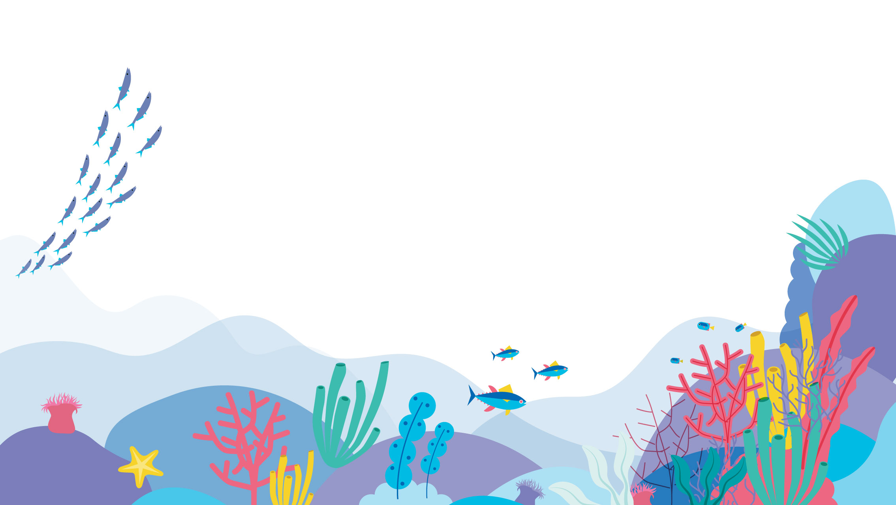







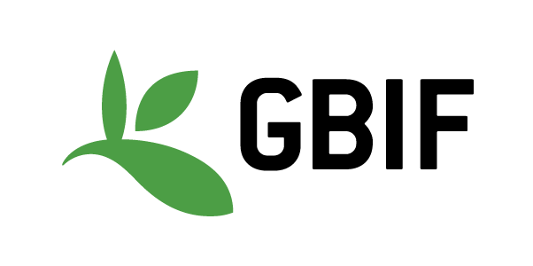


Notes:
As we’ve explored during the week, OBIS is a concept that is sustained and empowered by the efforts of a network of organizations, an assemblage of institutions that build data sharing software, design and maintain complex data systems, work out and evolve biological data standards and controlled vocabularies, and work within their areas of authority or expertise to produce datasets that conform to those standards and vocabularies.

Slide 3
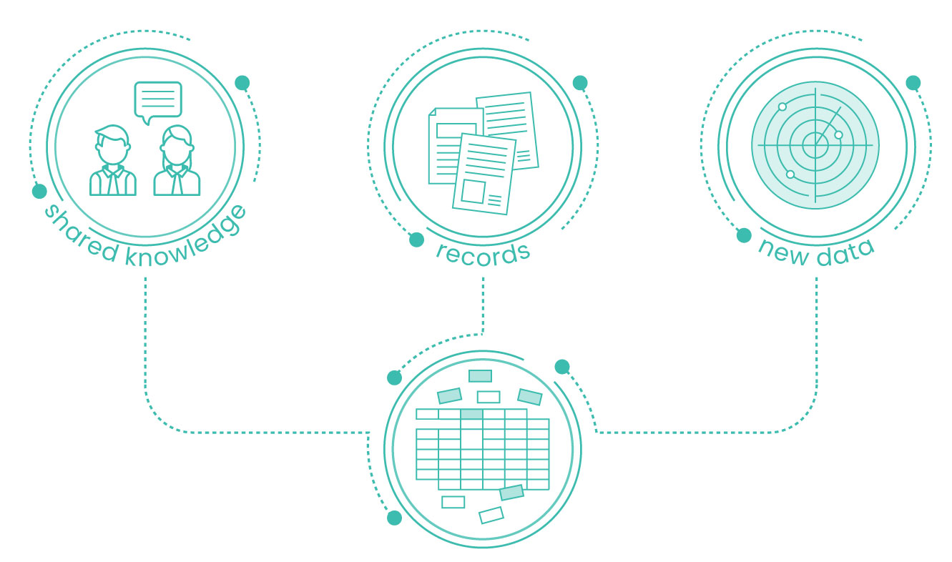
En tant que fournisseur de données
Collection :
Contribution à votre nœud national OBIS avec des données en cours et historiques
Notes:
So most of our focus this week is to increase your comfort level with identifying DarwinCore terms and structures that match your data, and to work through some of the QC that OBIS requires, to make it easier for you to be a data contributor, for the data you collect in the future and perhaps also the historic data that may not have made it into publication yet. Going back into older datasets and surfacing them and making them fit for publication can be very valuable work, and as we’ve seen with some of the use cases, and examples that have popped up during the workshop, that historic data can be valuable all over again when given the context required to support analyses and meta-analyses outside its original mandate.

Slide 4
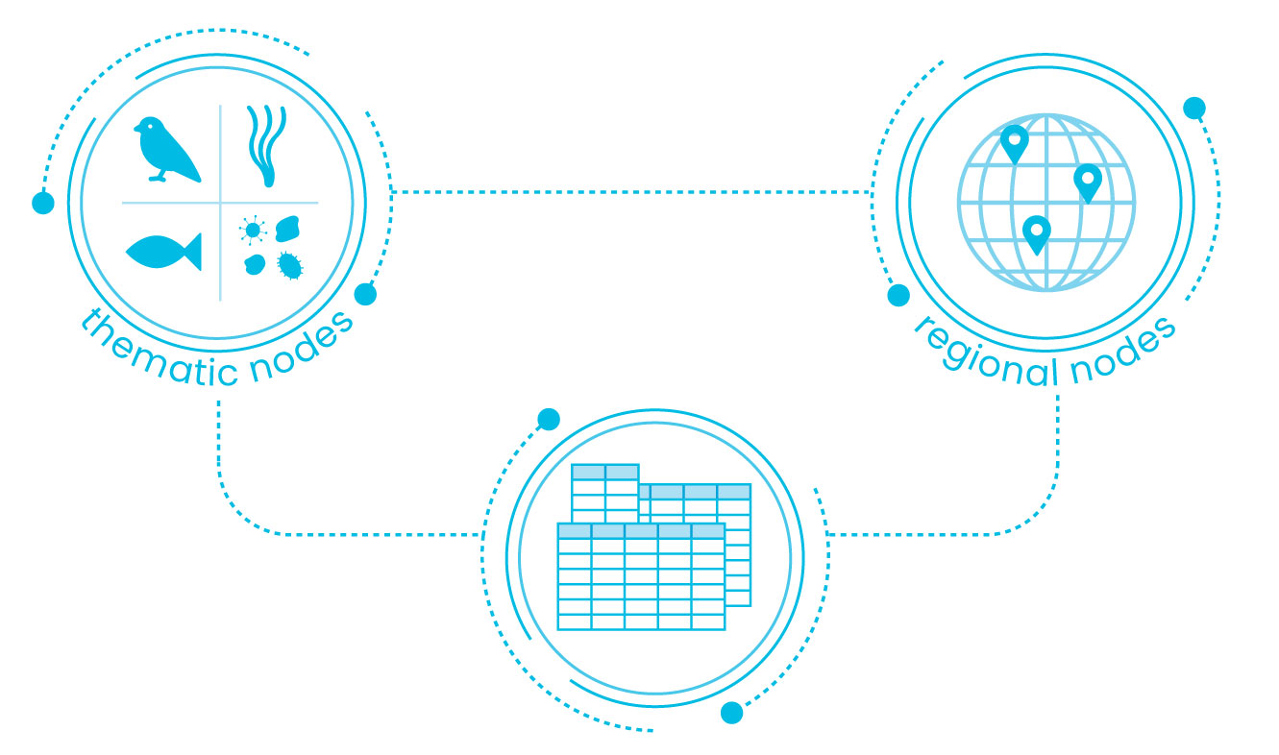
En tant que réviseur de données
Révision :
Les enregistrements présentement dans OBIS et OBIS Canada peuvent être revus et révisés
L’expertise dans le sujet est nécessaire pour réaliser ce travail
Notes:
There will always be more work to do in tidying up the data that’s already in OBIS, reviewing the data we find there and ensuring it is in good shape smooths the pathway for that data to be considered by analysts using OBIS data. Your expertise may make you unique in spotting some of the finer points, so I would recommend browsing around datasets and trying to use them if that’s something that you might enjoy doing. You’d be doing a service to all who come after you.

Slide 5
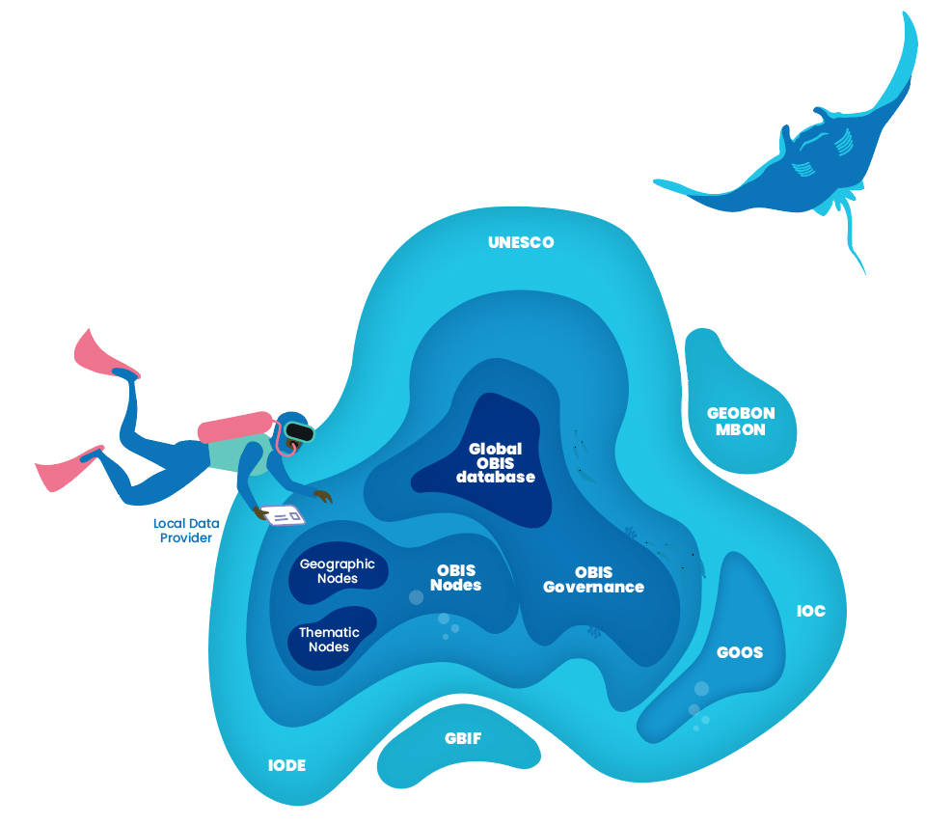
En tant que développeur de logiciels
GBIF maintient les IPT @ github.com/gbif/ipt/
Robis et le package OBIS : github.com/iobis
Implémentations d’API OBIS/WoRMS dans d’autres langues
Notes:
The IPT software is built as a Java Tomcat application, and has a small but dedicated developer base working on GitHub under the banner of the Global Biodiversity Information Facility. When we find problems and issues we can report them there, but if we’re experienced in building Tomcat apps, there is an opportunity there to pitch in and help develop the IPT to serve our purposes better.
The robis and obistools packages are developed by the OBIS project office, and are maintained on GitHub as well, and here I can tell you that you and a friend could double the number of developers working on these tools in R.
And if you’re not an R developer, say you are like me and prefer to work in Python, there are opportunities to implement things like robis or obistools in the language of your choice and bring another language the ability to check data and metadata and retrieve data records from OBIS quickly and easily.

Slide 6
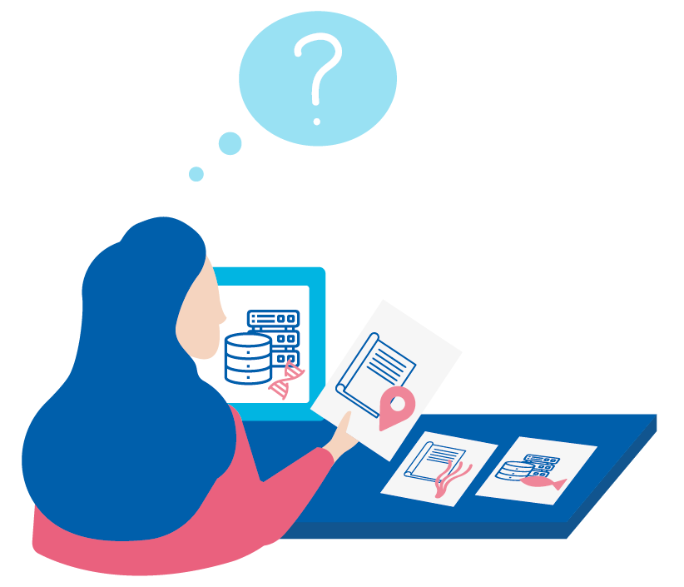
En tant qu’expert en taxonomie (WoRMS)
Les experts en taxonomie font du WoRMS ce qu’il est.
Des références taxonomiques mises à jour avec des noms historiques acceptés permettent de référencer d’anciennes et Nouvelles classifications taxonomiques en même temps
Comme pour tous efforts en données ouvertes, le travail volontaire demande des experts comme vous!
On ne saurait faire ce qu’on fait sans…
Notes:
And we saw on the first day that our world registry of marine species relies on taxonomic experts around the globe to ensure the accuracy and currency of the taxonomic definitions their API returns. There aren’t that many folks in the world capable of performing this work, and if you’re one of those people, this is a pretty critical part of our biodiversity data management ecosystem, and there are some interesting questions that are going to be grappled with over the next few years at the intersection of taxonomy and biodiversity.

Slide 7
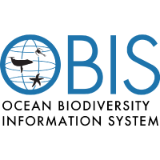


Développement collaboratif
https://github.com/iobis/
https://github.com/tdwg/
Contribution aux normes et aux cas d’utilisation
Travailler à l’élaboration de nouvelles méthodes DwC et OBIS, travailler avec les pairs dans des forums ouverts
Créer des cas d’utilisation pour guider les nouveaux utilisateurs vers les meilleures pratiques

Slide 8
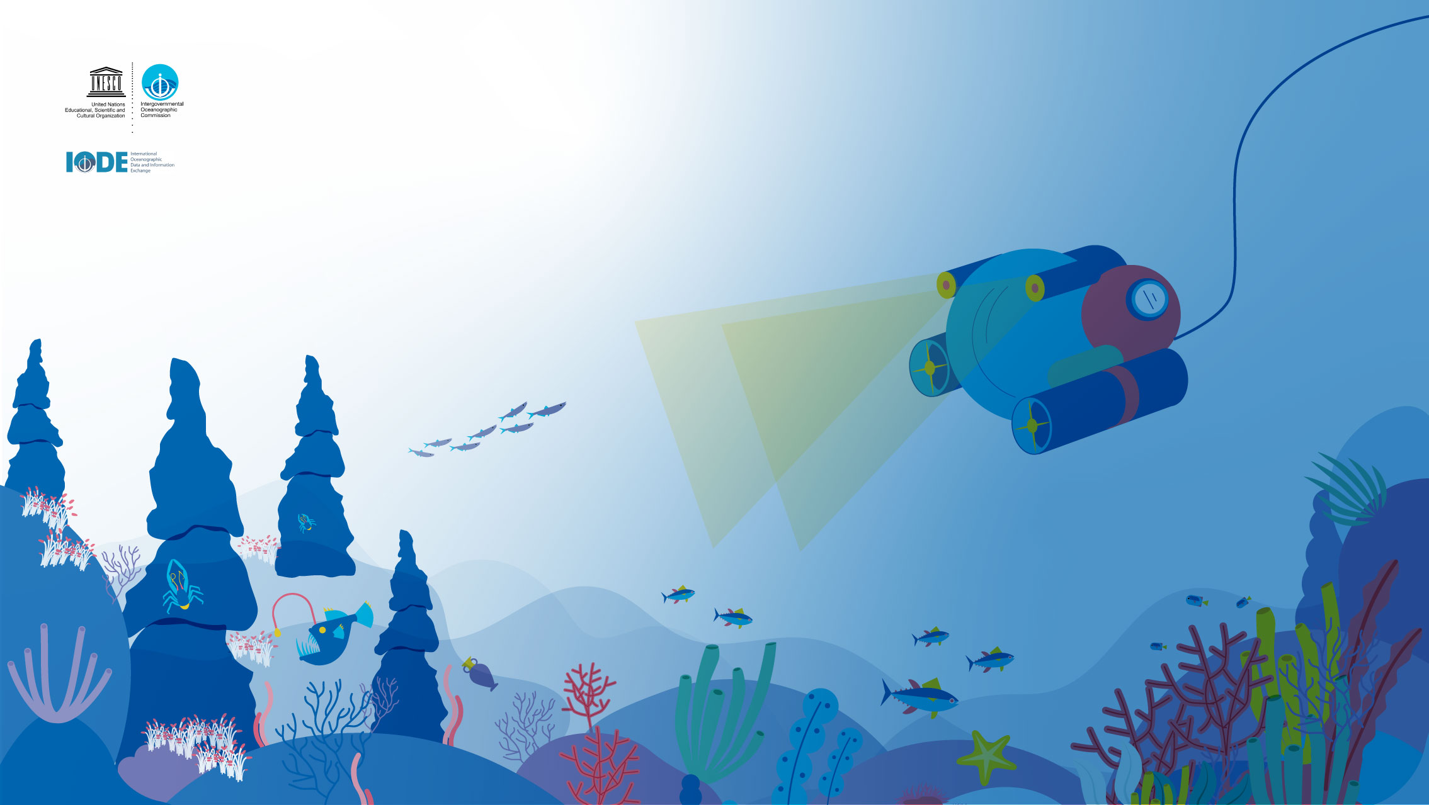
Merci
Notes:
OBIS never misses an opportunity to thank to all the supporters, donors and the thousands of scientists and the hundreds of data managers who have been involved and contributed to OBIS. Without their efforts we would not have this fantastic resource to use today and in the future by our children.

Slide 9





@oceantrackingnetwork
@oceantracking
oceantrackingnetwork.org

